Slide 1
IE 7374 Machine Learning in Engineering
Ramin Mohammadi
Northeastern University

Slide 2
Outline
Preview of the course
Why Machine Learning?
What is Machine Learning?
Types of Machine Learning models?

Slide 3
Syllabus

Slide 4
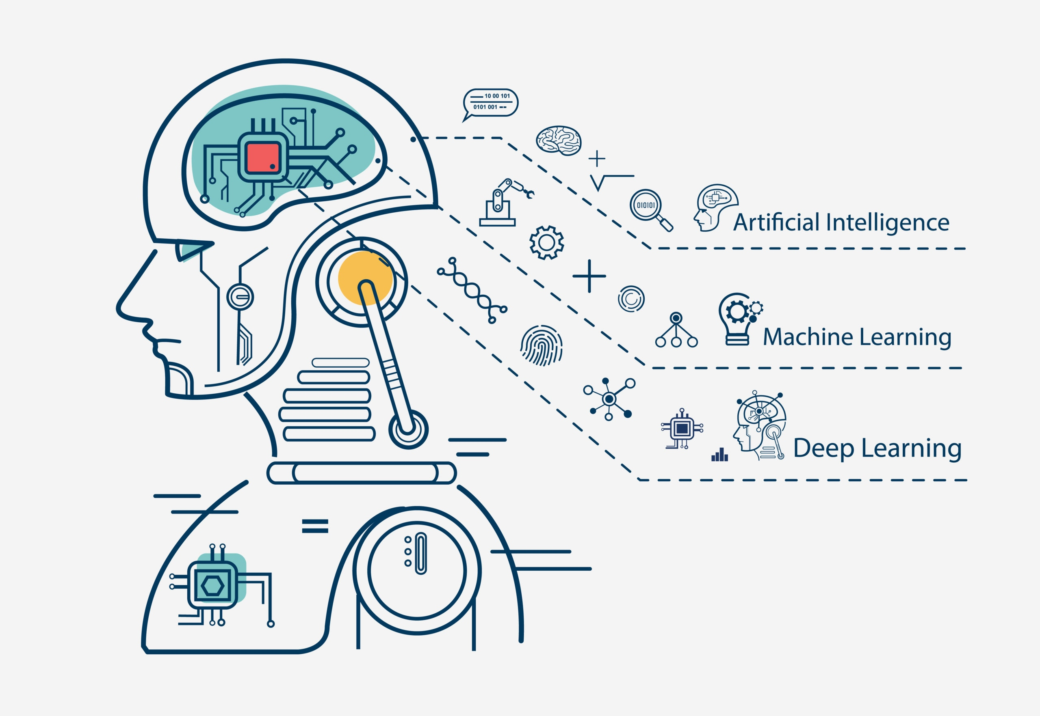
Machine Learning
While artificial intelligence (AI) is the broad science of mimicking human abilities, machine learning is a specific subset of AI that trains a machine how to learn.

Slide 5
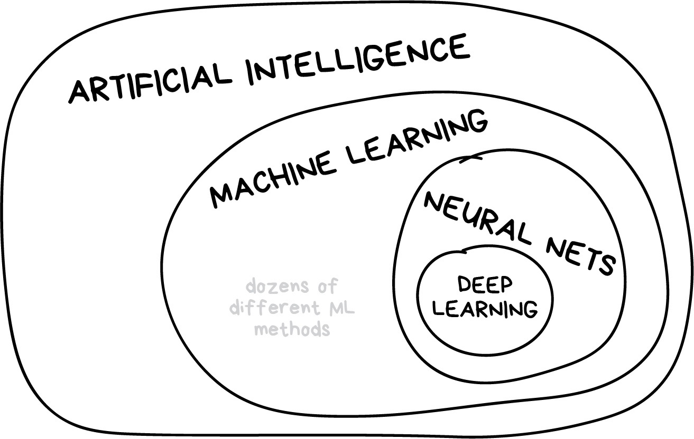
Learning vs Intelligence

Slide 6

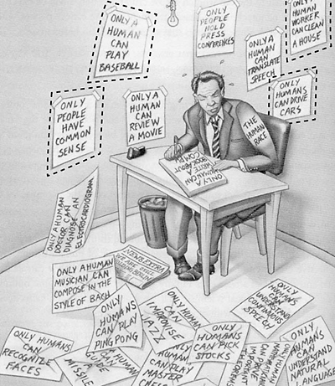
Why Machine Learning

Slide 7
What is Machine Learning
Machine Learning: Field of study that gives computers the ability to learn without being explicitly programmed. - Arthur Samuel (1959).
we define machine learning as:
a set of methods that can automatically detect patterns in data, And use the uncovered patterns to predict future data, Or to perform other kinds of decision making under uncertainty.
Machine Learning Glossary

Slide 8
Why Machine Learning?
We are entering the era of big data.
There are about 1 trillion web pages.¹
One hour of video is uploaded to YouTube every second, amounting to 10 years of content every day. ¹
the genomes of 1000s of people, each of which has a length of 3.8 × 109 base pairs, have been sequenced by various labs.¹
Walmart handles more than 1M transactions per hour and has databases containing more than 2.5 petabytes (2.5 × 1015) of information.¹
This deluge of data calls for automated methods of data analysis, which is what machine learning provides.

Slide 9
Well-posed Learning Problem: A computer program is said to learn from experience E with respect to some task T and some performance measure P, if its performance on T, as measured by P, improves with experience E. Tom Mitchell (1998)
Prediction Problems
One common theme is to solve a prediction problem:
given an input x,
predict an “appropriate” output y.
We'll start with a few real-life examples...

Slide 10
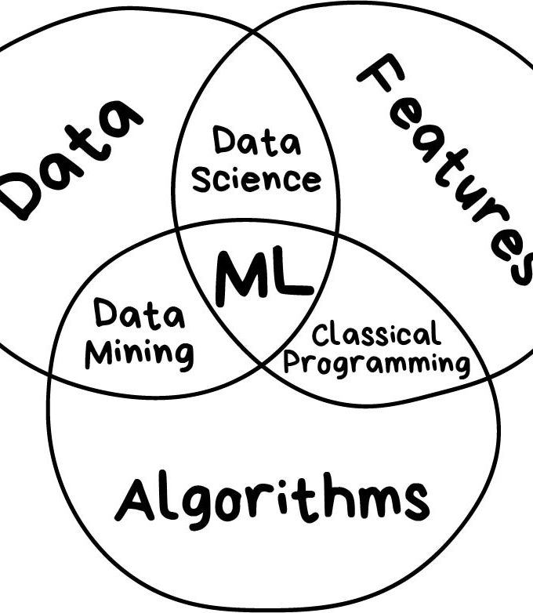
Machine Learning Components

Slide 11
Examples

Slide 12
Bank applications
Suppose your bank program watches loan applications and either approves/rejects, and based on that learns how to better make decisions on loan applications. What is the task T in this setting?
Classifying applications as accepted or rejected.
Watching you label applications as accepted or rejected.
The number (or fraction) of applications correctly classified as accepted or rejected.
None of the above—this is not a machine learning problem.

Slide 13
Natural Language Processing
Subset of size 16242 x 100 of the 20-newsgroups data. We only show 1000 rows, for clarity.
Each row is a document (represented as a bag-of-words bit vector), each column is a word.
The red lines separate the 4 classes.

Slide 14
Image Processing
Three types of iris flowers: Setosa, Versicolor and Virginica.

Slide 15

The map of the machine learning world

Slide 16
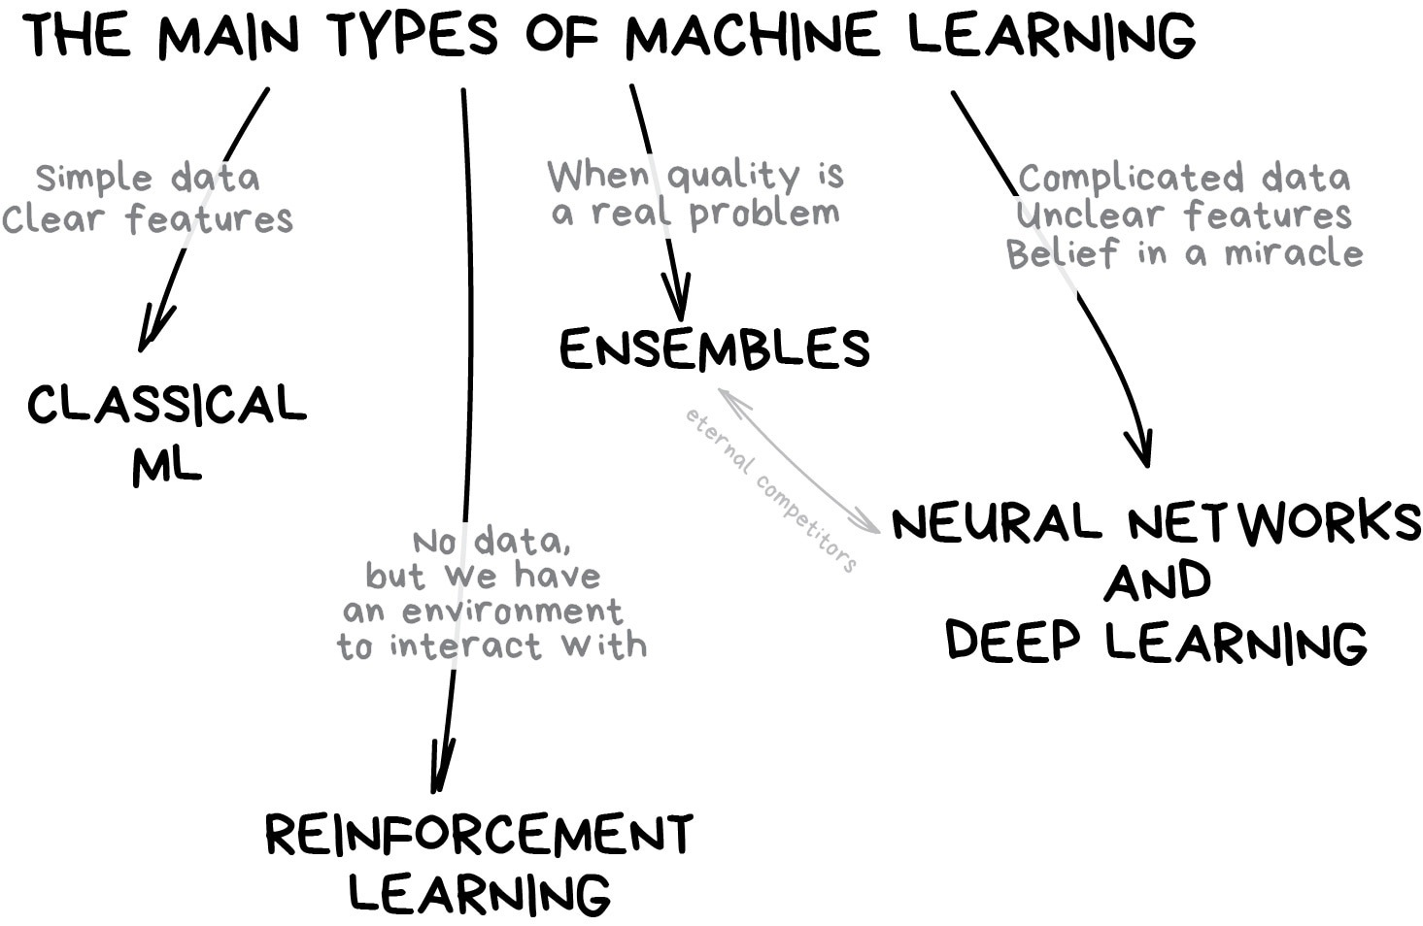

Slide 17
Classical Machine Learning
The first methods came from pure statistics in the '50s. They solved formal math tasks — searching for patterns in numbers, evaluating the proximity of data points, and calculating vectors' directions.
When you see a list of articles to "read next“.
Your bank blocks your card at random gas station in the middle of nowhere.

Slide 18


Slide 19
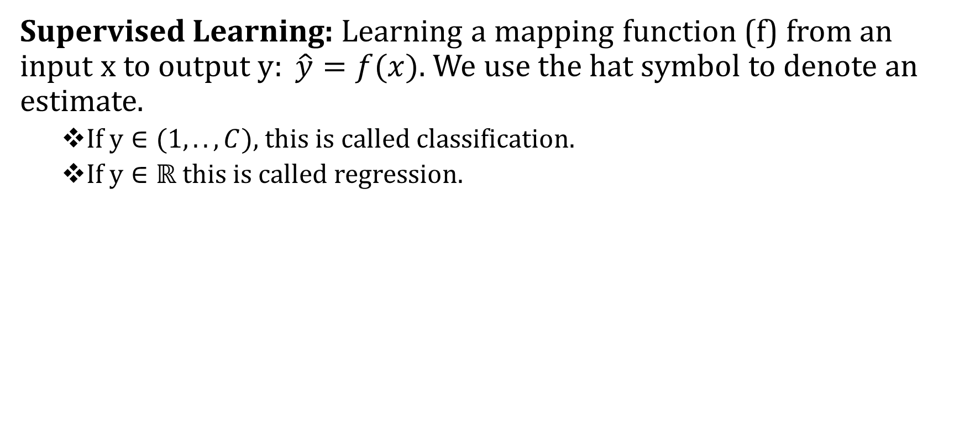
Categories of Machine Learning
Supervised Learning: Learning a mapping function (f) from an input x to output $y: \hat{y}=f(x)$. We use the hat symbol to denote an estimate.
If $y∈(1, ..,C)$, this is called classification.
If $y∈ℝ$this is called regression.

Slide 20
Unsupervised Learning: where we are just given input data, without any outputs.
The goal is to discover “interesting structure” in the data; this is sometimes called knowledge discovery.

Slide 21
Semi-supervised Learning:
Some training data annotated
Have category labels
More training data available — but no labels!
E.g., large collection of images, only some annotated

Slide 22

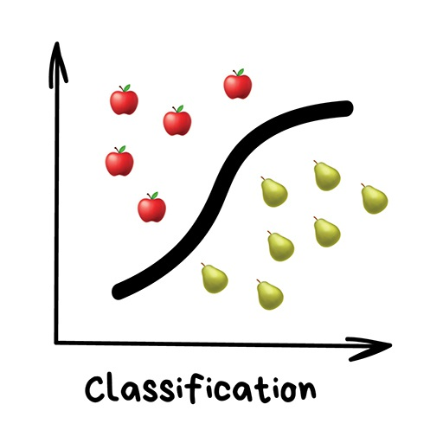
Classification
Classical machine learning is often divided into two categories Supervised and Unsupervised Learning.
Today used for:
– Spam filtering
– Language detection
– A search of similar documents
– Sentiment analysis
– Recognition of handwritten characters and numbers
– Fraud detection

Slide 23
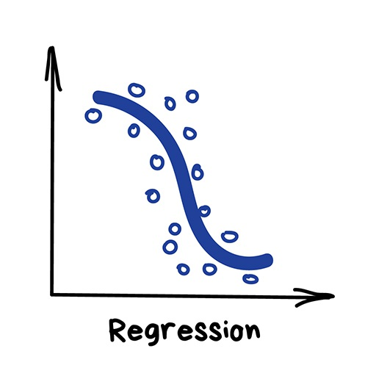
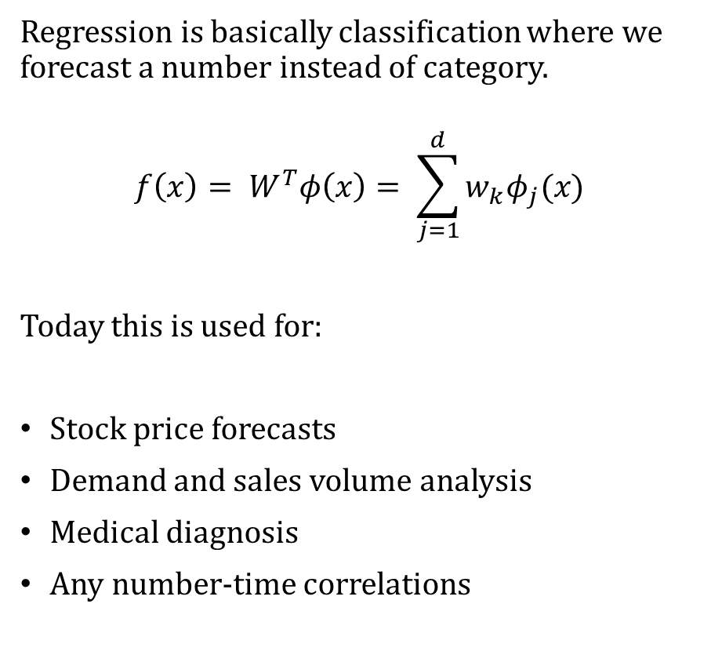
Regression
Regression is basically classification where we forecast a number instead of category.
$$f\left(x\right)= W^{T}φ\left(x\right)= \sum_{j=1}^{d}{w_{k}φ_{j}(x)}$$
Today this is used for:
Stock price forecasts
Demand and sales volume analysis
Medical diagnosis
Any number-time correlations

Slide 24
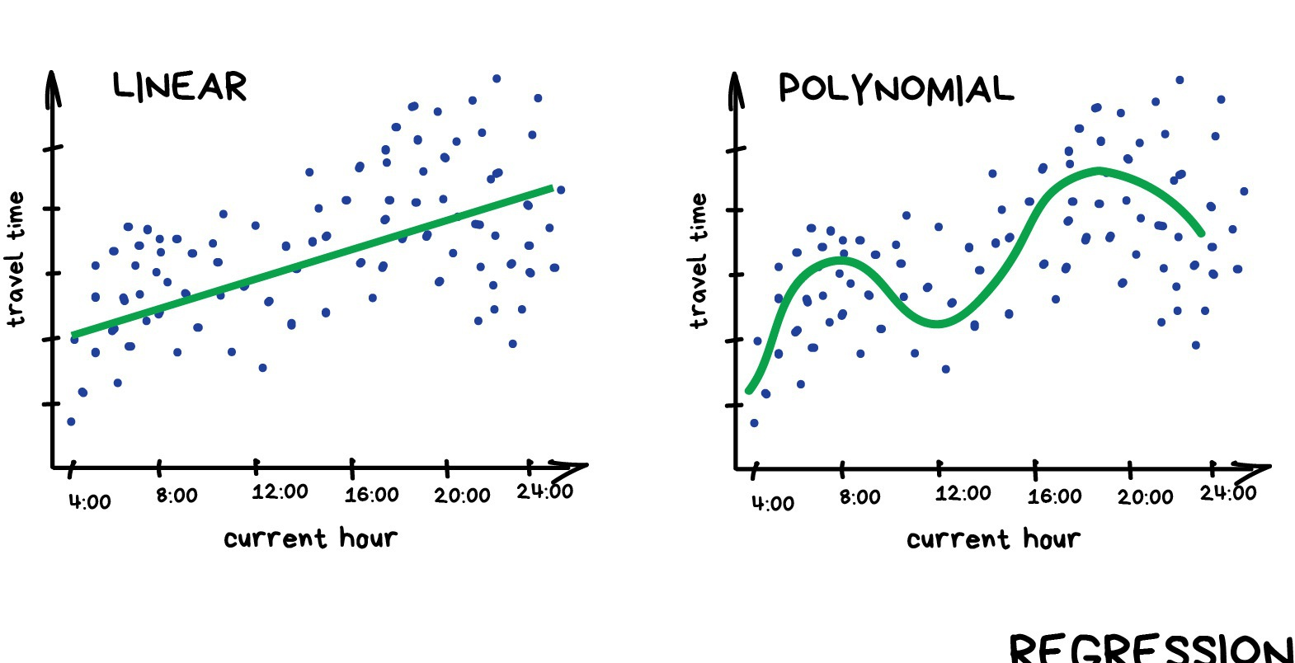

Slide 25
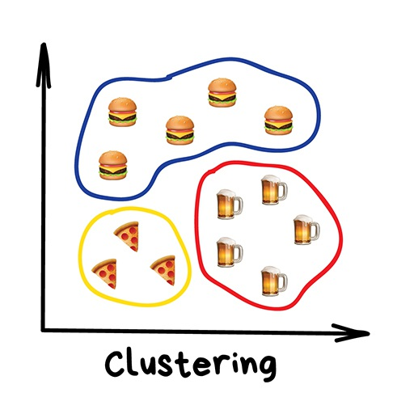
Clustering
Divides objects based on unknown features. Machine chooses the best way.
Nowadays used:
For market segmentation (types of customers, loyalty)
To merge close points on a map
For image compression
To analyze and label new data
To detect abnormal behavior

Slide 26
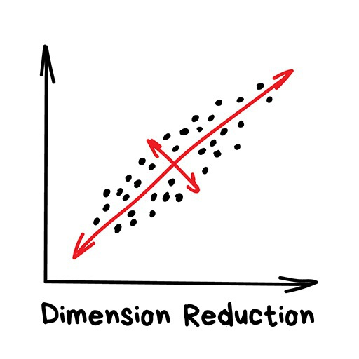
Dimensionality Reduction
Assembles specific features into more high-level ones
Nowadays is used for:
Recommender systems
Beautiful visualizations
Topic modeling and similar document search
Fake image analysis
Risk management

Slide 27
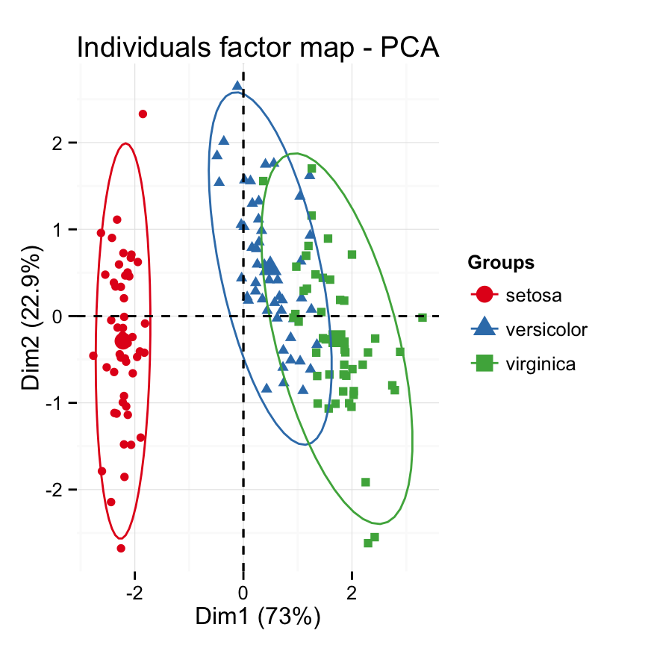
Principal Component Analysis (PCA)
This Photo by Unknown Author is licensed under CC BY-SA-NC

Slide 28
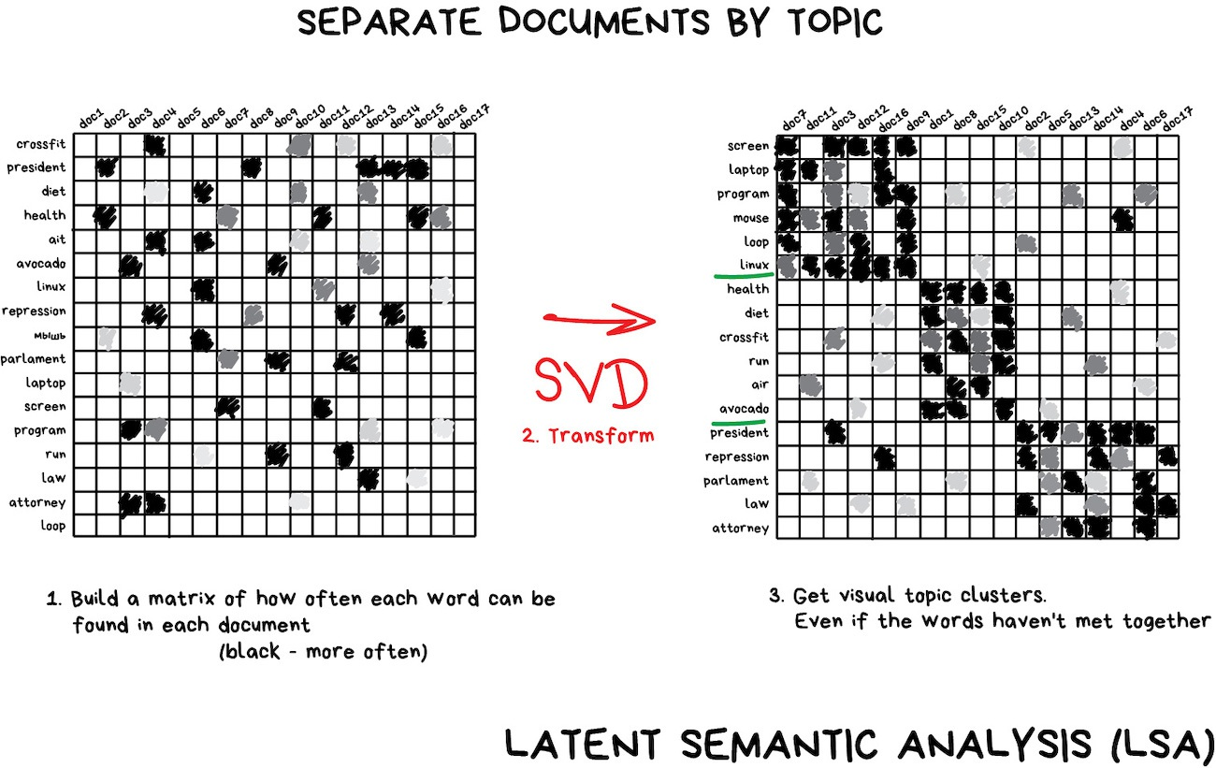
Singular Value Decomposition (SVD)

Slide 29
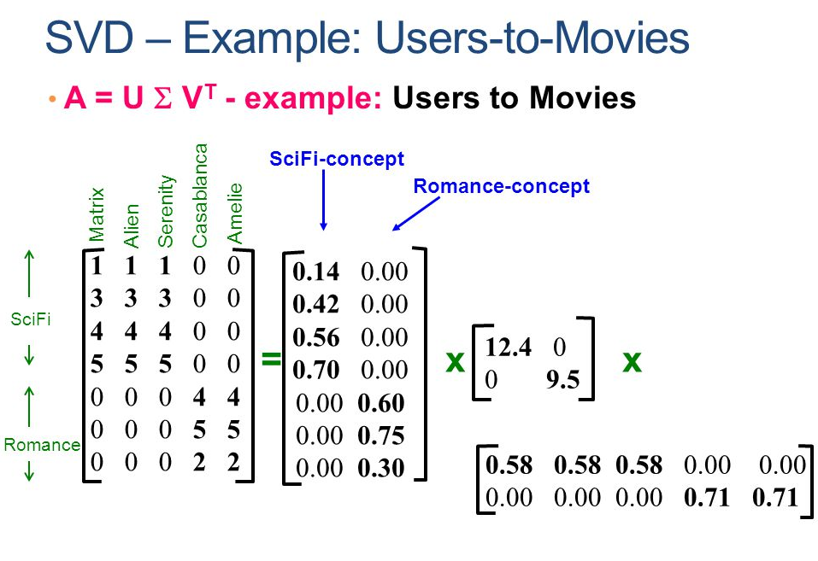

Slide 30
Basic Concepts in Machine Learning
Parametric vs non-parametric models
A simple non-parametric classifier: K-nearest neighbors
Parametric models for classification and regression
Linear regression
Logistic regression
The curse of dimensionality
Bias-Variance tradeoff
Overfitting and Underfitting
Model selection
No free lunch theorem

Slide 31
Parametric vs non-parametric models
parametric model: Number of parameters are fixed.
Faster to use (Pros)
Making stronger assumptions about the nature of the data distribution (Cons)
non-parametric model: the number of parameters grow with the amount of training data
More flexible (Pros)
Computationally intractable for larger datasets (Cons)

Slide 32
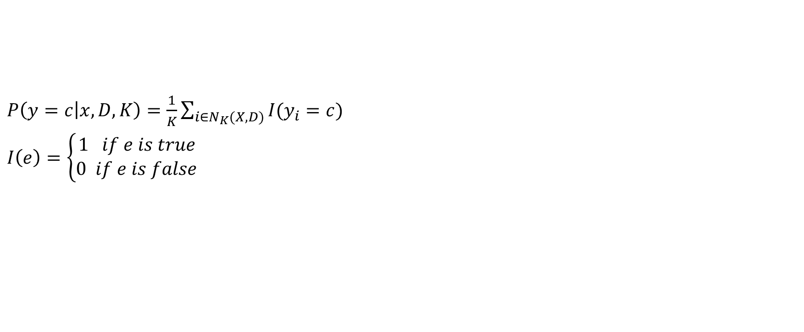
A simple non-parametric classifier: K-nearest neighbors
$P\left(y=c | x, D, K\right)=\frac{1}{K}\sum_{i∈N_{K}(X,D)}{I(y_{i}=c)}$
$I\left(e\right)=\left\{\begin{aligned}1 if e is true \\ 0 if e is false\end{aligned}\right.$

Slide 33
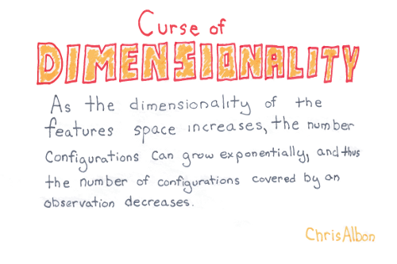
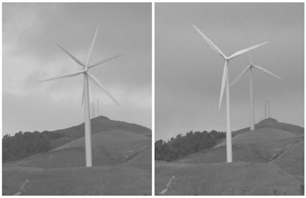
The curse of dimensionality
If we’re recording 60 different metrics for each of our shoppers, we’re working in a space with 60 dimensions.
If we’re analyzing grayscale images sized 50x50, we’re working in a space with 2,500 dimensions.
If the images are RGB-colored, the dimensionality increases to 7,500 dimensions (one dimension for each color channel in each pixel in the image).

Slide 34
Bias-Variance Tradeoff
Bias is the amount of error introduced by approximating real-world phenomena with a simplified model.
Variance is how much your model's test error changes based on variation in the training data. It reflects the model's sensitivity to the idiosyncrasies of the data set it was trained on.

Slide 35
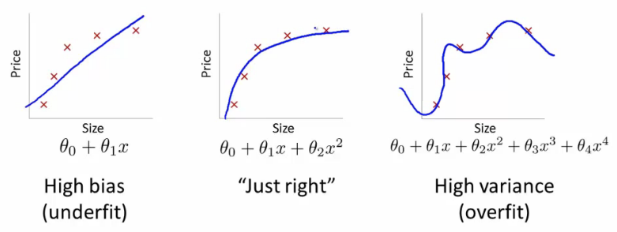
Overfitting and Underfitting

Slide 36
No Free Lunch Theorem
All models are wrong, but some models are useful. — George Box (Box and Draper 1987, p424).12
There is no universally best model — this is sometimes called the no free lunch theorem (Wolpert 1996). The reason for this is that a set of assumptions that works well in one domain may work poorly in another.

